Slide 1
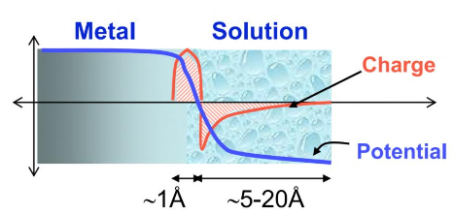
Applied voltage in atomistic simulations II: Methods for classical and ML-based MD
Zachary K. Goldsmith
CCCE Interfaces and Applied Voltage Working Group
November 25th, 2025
W. Schmickler & E. Santos, Interfacial Electrochemistry, 2010

Slide 2
Outline
Recap of definition of electrode potential and DFT/half cell methods
Machine learning potentials in the grand canonical ensemble
Methods for molecular dynamics under applied electrode bias
Constant Potential Method a.k.a. Siepmann-Sprik
External electric field approaches
Applicability of both with MLIPs
Outlook for battery modeling: from training on half cells to simulating half cells to ultimately full cells

Slide 3
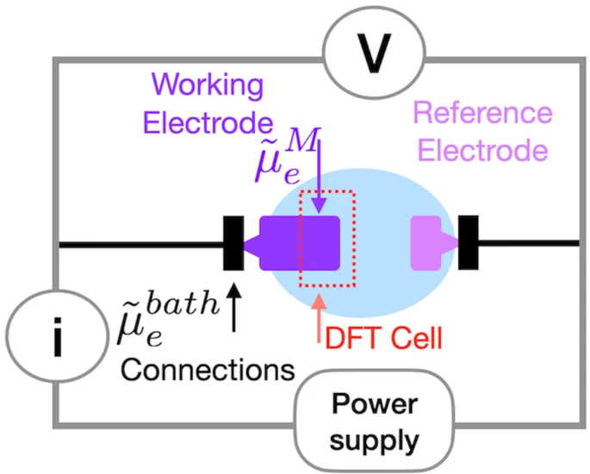
The electrode potential
Cell voltage is governed by the voltage difference between the anode and cathode
Experimentally this is often achieved using a reference electrode
Electrons freely flow through the circuitry to maintain this voltage
Periodic DFT cells can only realistically accommodate a half-cell: one electrode and its interface with electrolyte
How can one apply and control an electrode potential that is necessarily defined relative to a counter electrode?
Melander, Wu, Weckman, Honkala, npj Comput. Mat., 2024
NB: batteries are Galvanic—not electrolytic—cells so there isn’t an external power supply

Slide 4
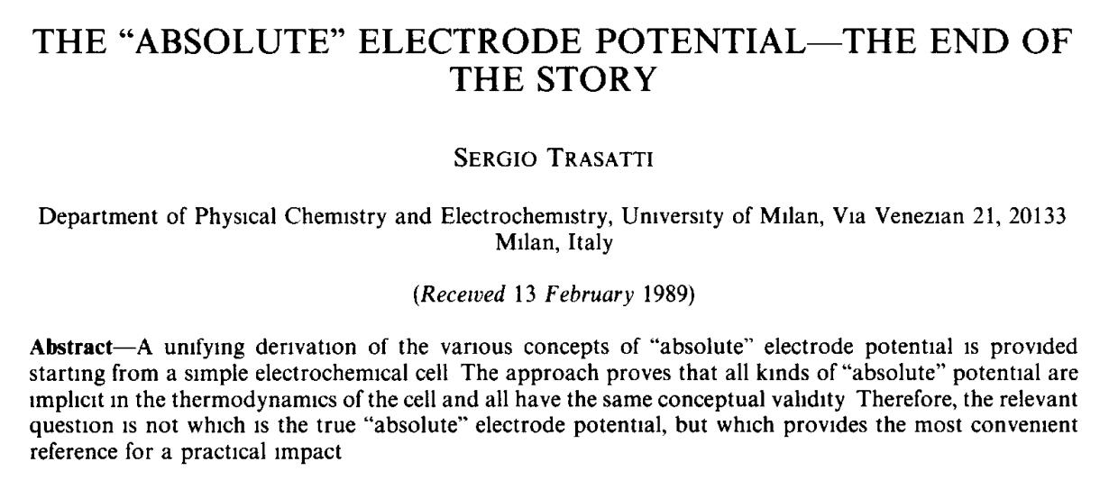
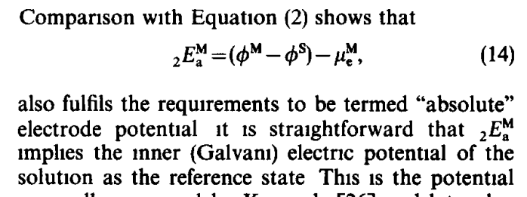
The electrode potential has several expressions
Electrochim. Acta
Trasatti unified existing definitions using the rigorous thermochemical origins of electrode potentials
Defined electrode potentials using computationally realizable terms, i.e. electrostatic (Hartree+nuclear) potential values and chemical potentials of electrons (Fermi energy)

Slide 5
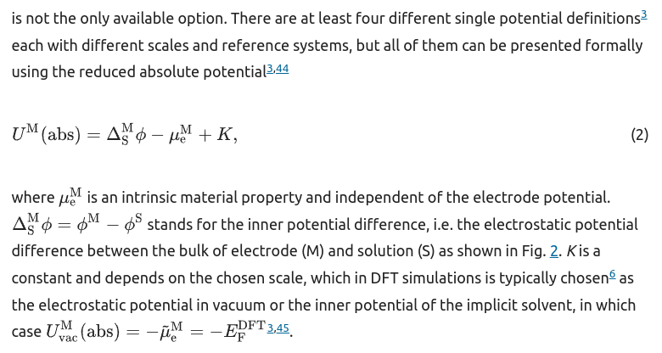
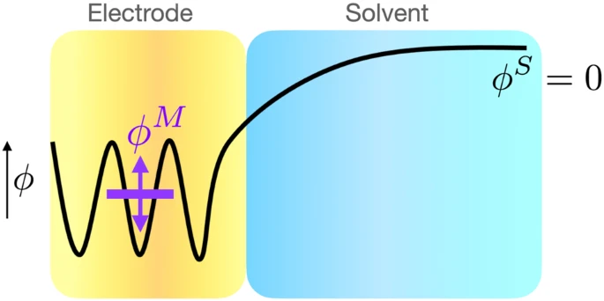
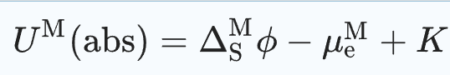
Expressing electrode potential in a half-cell
Absolute potential can be expressed in terms of the electrostatic potential difference between deep in the metal and deep in solution as well as the intrinsic chemical potential of electrons in the metal (Fermi energy or inverse work function)
DFT methods for half-cells in the grand canonical ensemble have been developed
Melander, Wu, Weckman, Honkala, npj Comput. Mat., 2024

Slide 6
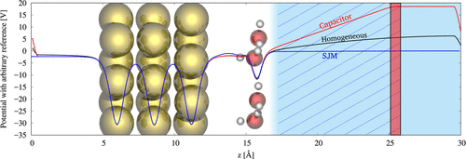
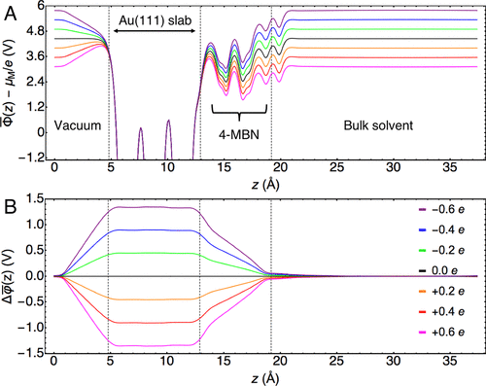
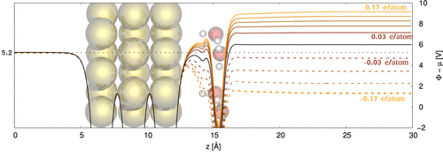
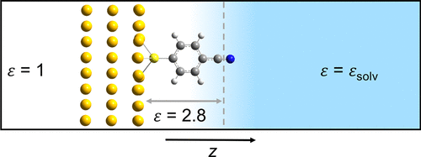
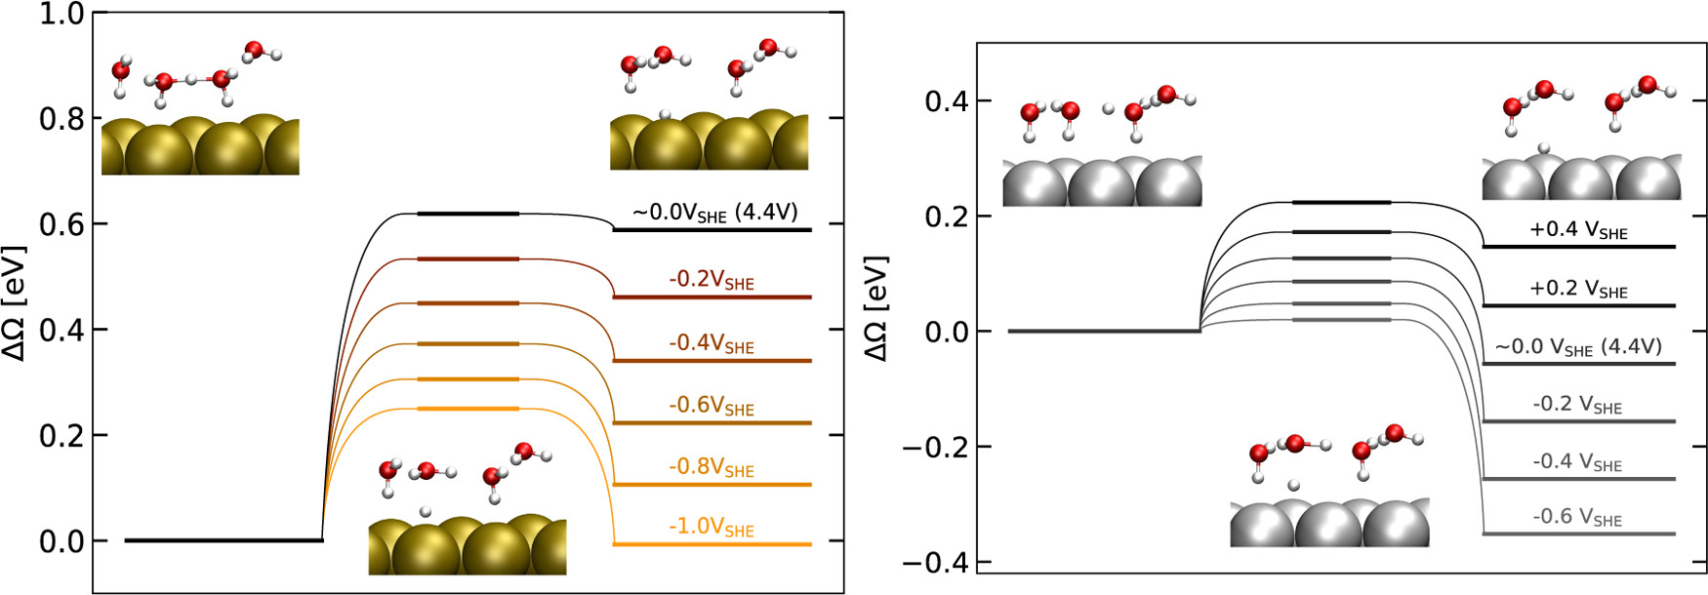
Electrode potential in practice: Static calculations
Exploiting fractional charge and implicit solvation in periodic DFT calculations allows for smooth change to the applied voltage
Differential capacitance governs the charge needed to apply a given potential
Kastlunger, Lindgren, Peterson, JPC C, 2018
Goldsmith, Secor, Hammes-Schiffer, ACS Cent. Sci., 2020

Slide 7
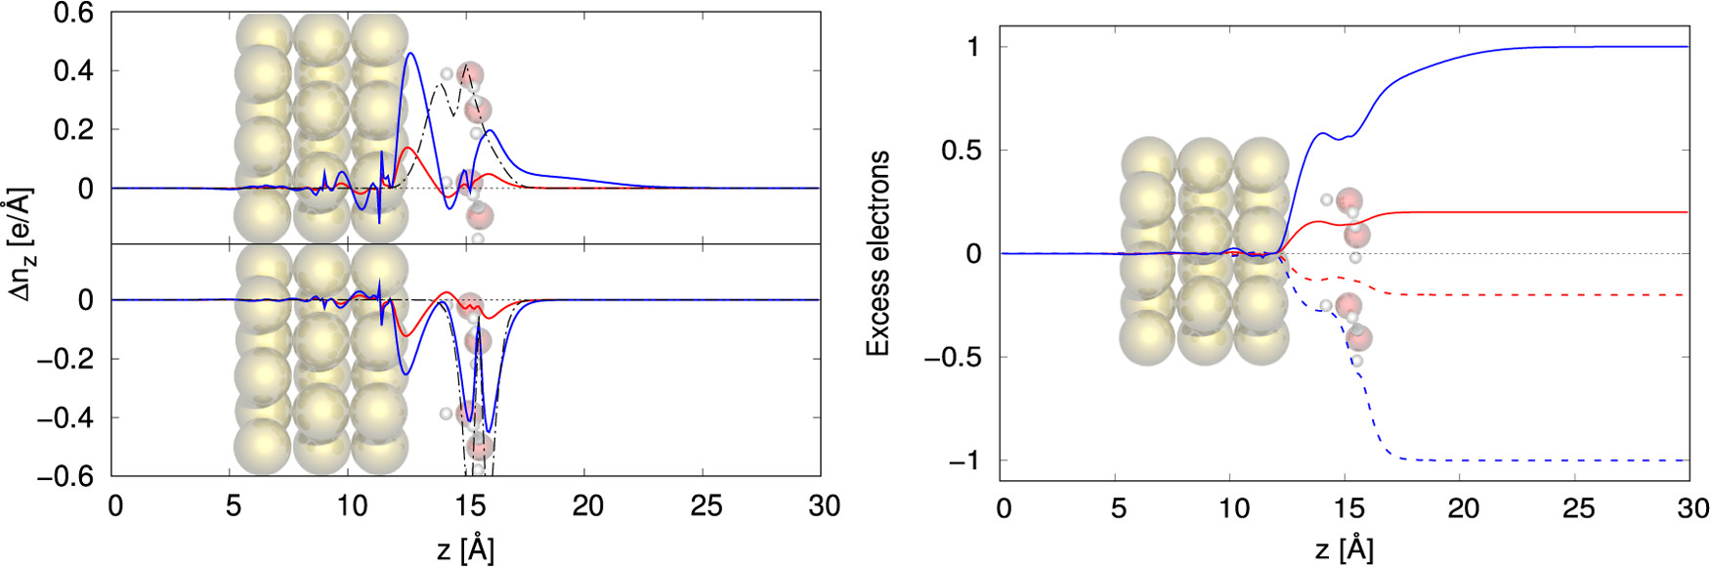
Electrode potential in practice
Note that a carefully constructed and bounded simulation cell allows for overwhelming localization of excess charge on one “active” surface
Kastlunger, Lindgren, Peterson, JPC C, 2018

Slide 8
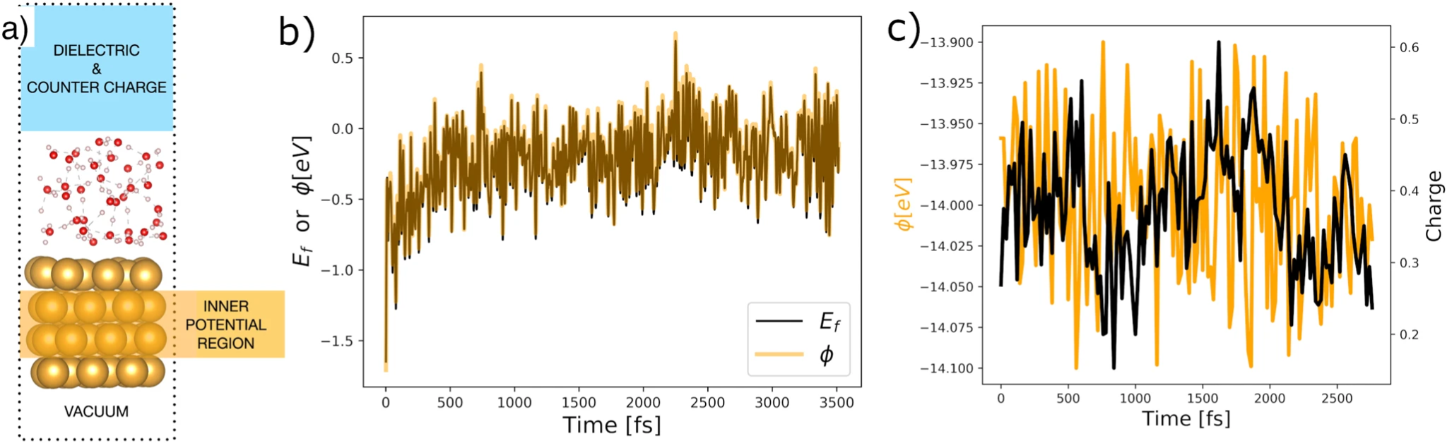
Dynamics exhibit the charge-potential relationship
AIMD of water @ negatively polarized gold electrode done with both fixed charge and fixed (inner) potential
Charge and potential behave like conjugate variables: fix one and the other fluctuates around an equilibrium value
Melander, Wu, Weckman, Honkala, npj Comput. Mat., 2024

Slide 9
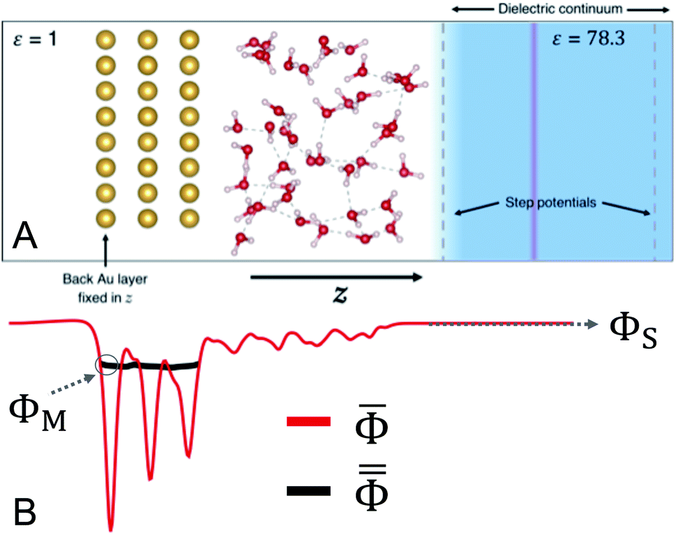
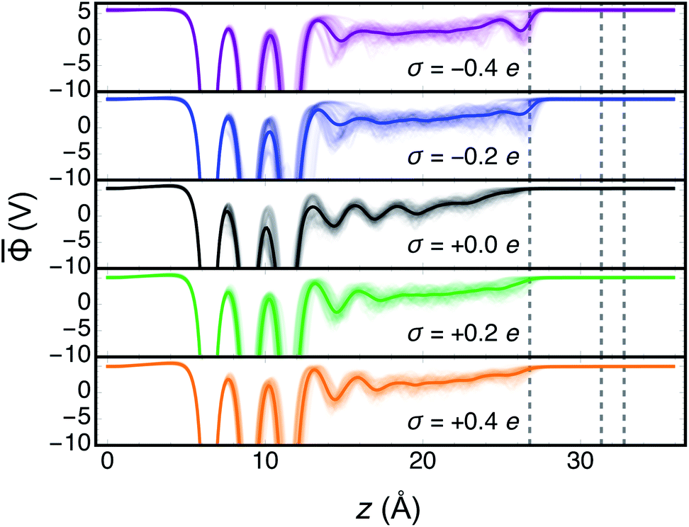
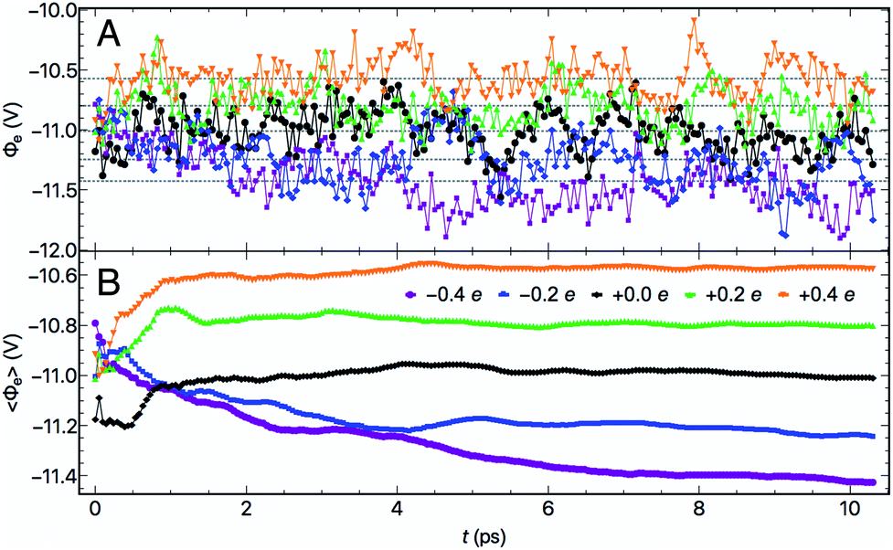
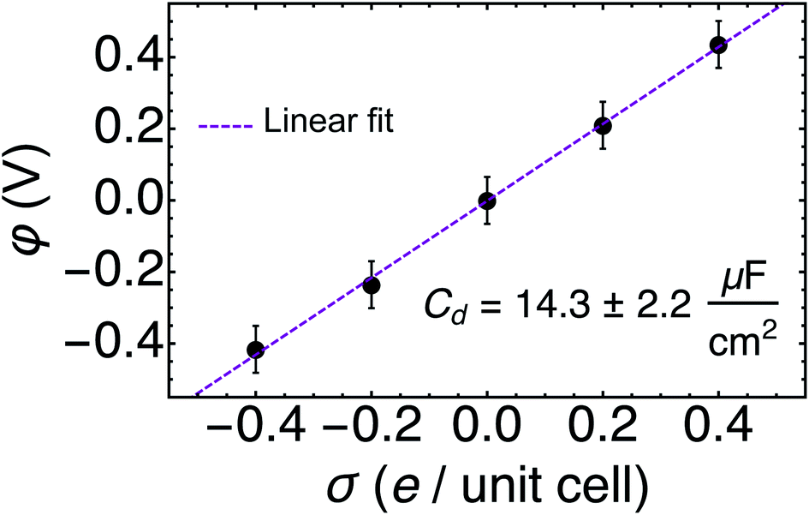
Dynamics exhibit the charge-potential relationship
AIMD of water @ gold electrode w/ 5 different constant charge values
Average potential converges despite significant, persistent fluctuations
Differential capacitance in agreement with experiment
Goldsmith, Calegari Andrade, Selloni, Chem. Sci., 2021

Slide 10
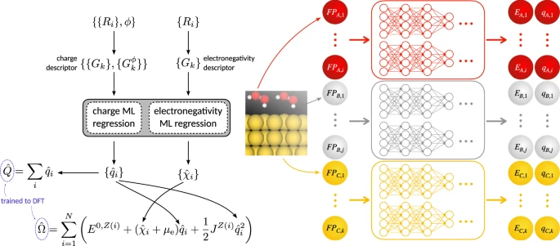
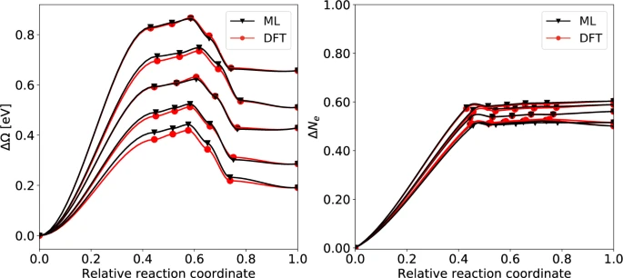
Machine learning in the GC ensemble
Machine-learning in the GC ensemble for proton discharge on gold
QEq-like approach coupled to GPAW periodic DFT with SJM for training
One NN predicts charges from geometry + potential, one predicts electronegativities from geometry
Geometry encoding electronegativity → no need to designate surface/electrode atoms
ML simulations reproduce Faradaic proton discharge at various voltages
Chen, Willard, Peterson et al., npj Comp. Mat., 2023

Slide 11
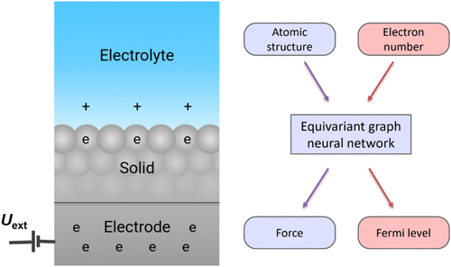

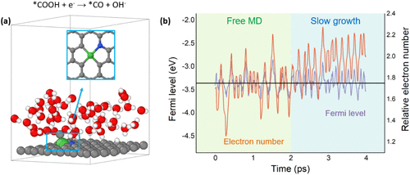
Machine learning in the GC ensemble
Fermi level can be learned in the training procedure
This study trained at a single potential rather than one that can vary

Slide 12
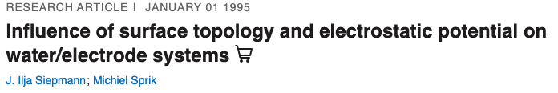
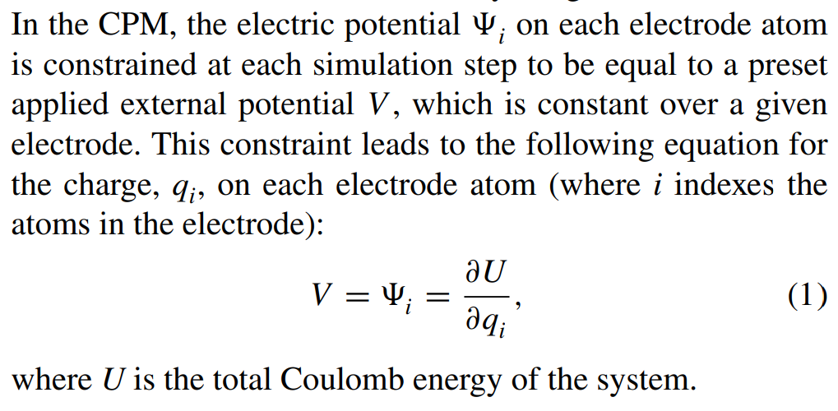
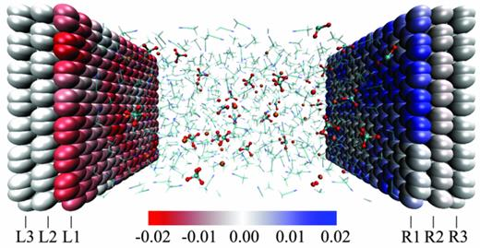
Constant potential in charge-aware MD
Charges on designated metal sites satisfy a constraint according to the applied potential
Equations of motion for r and q_{i} solved together
Wang, Yang, Olmsted, Asta, Laird, JCP, 2014

Slide 13
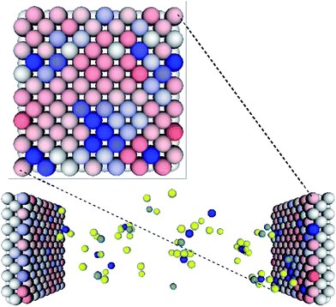
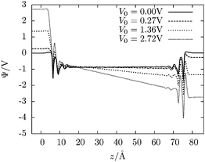
Model electrode in contact with aqueous electrolyte
Ru2+/3+ “electrodes” in contact with aqueous NaCl
Constant potential method engenders potential drop from one side of the cell to the other
Electrostatic potentials in bulk solution are not flat at large biases, however
Color coding shows how local polarization environment of electrode atoms allows for different partial charges
∇²𝛹 = -ρ/ε₀
Willard, Reed, Madden, Chandler, Faraday Discuss., 2009

Slide 14
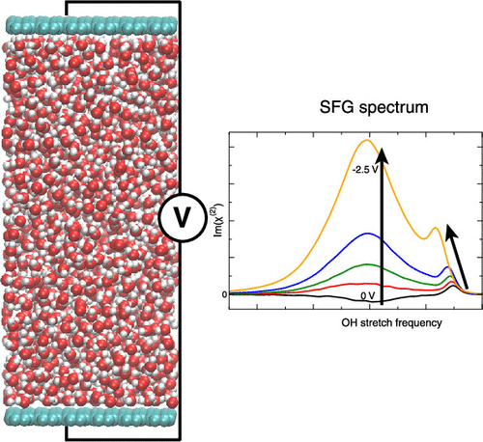
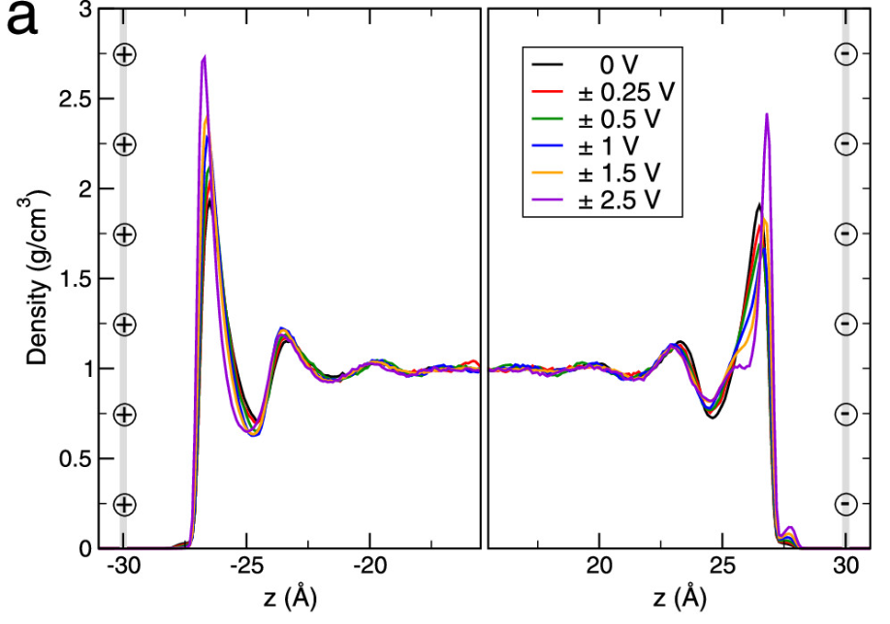
Model electrode in contact with aqueous electrolyte
CPM for 2D periodic cell of graphene in contact with water
SFG spectrum computed at various applied biases according to the method
Zhang, Aguiar, Hynes, Laage, JPCL, 2020

Slide 15
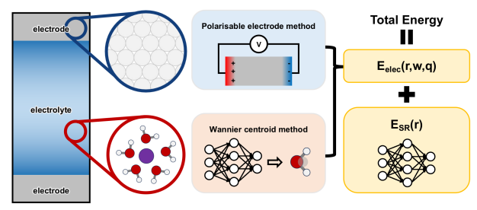
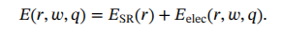
Coupling constant potential methods to MLIPs
Siepmann-Sprik potentiostat can in principle be coupled to MLFFs
DeepMD coupled to Siepmann-Sprik method adds the external potential as the long-range electrostatic part
Intra-system long-range electrostatics are also included via WCs
Pt(111)-KF(aq) system studied
Pt cannot be described by WCs, so the electrode atoms had to be designated specifically for Siepmann-Sprik treatment
There are not a lot of these examples, however
Zhu & Cheng, PRL, 2025

Slide 16
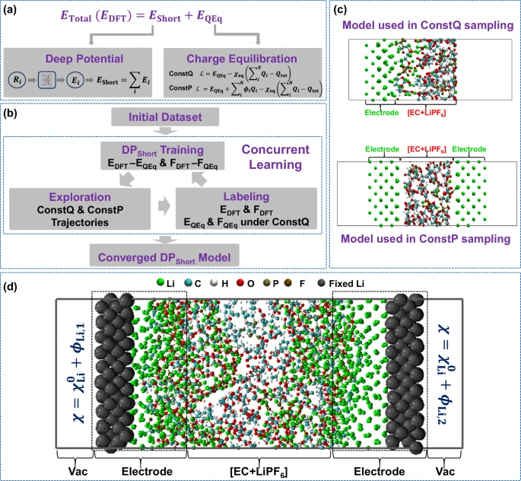
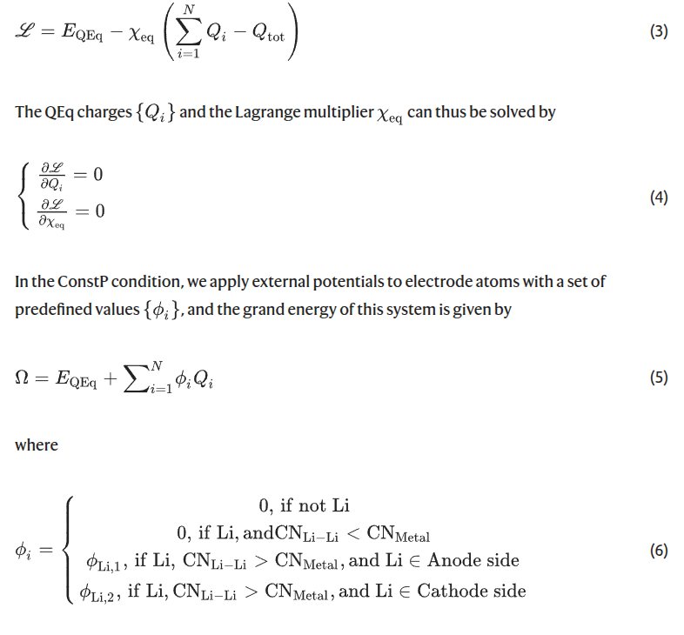
Coupling constant potential methods to MLIPs
Li dendrite growth modeled with a MLFF+QEq model with constant potential method
Lagrangian with piecewise scheme for applied potential on Li metal atoms
Xu et al., Nat. Comm., 2025

Slide 17
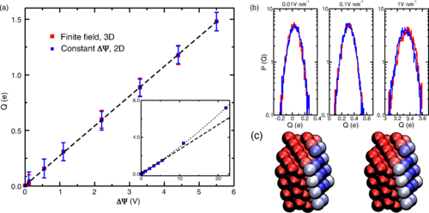
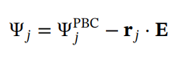
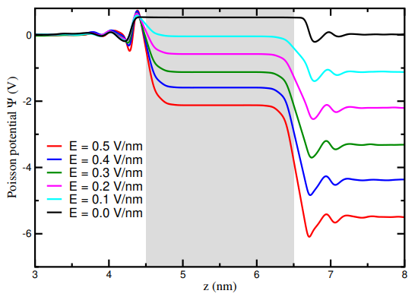
Applied potential vis-a-vis applied electric field
A macroscopic electric field can impose a potential drop from one end of the cell to the other
This can be equivalent to 2D CPM so long as the Ewald summation for finite field method is done in 2D PBC
This method works even with empirical FFs
“Double layer”-like potential drops at the interfaces and flat electrostatic potentials in bulk solid and bulk electrolyte
Maybe an option at the multi-scale phase of the project
Dufils et al., PRL, 2019

Slide 18
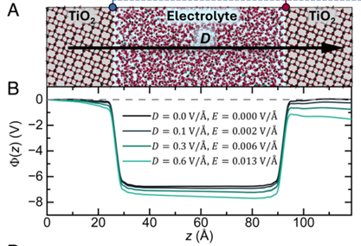
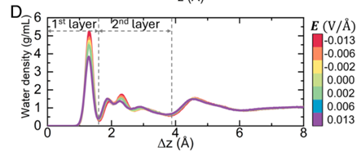
Applied D-field DeepMD
Semiconductor-electrolyte interface studied with DPLR (Wannier function-based)
Dynamics conducted with constant D field values: electrostatic potential drops a finite amount across the cell as a result
Const. D is the “open-circuit” condition
Non-zero field in bulk solution is unphysical
Need to train in presence of field?
Finite size effect?
Effects of field/potential on water structure and dissociation studied
Constant D or E field methods may not be well-behaved for metallic electrodes
Zhang, Yu, Car, Selloni, PNAS, 2025

Slide 19
Open questions for models and simulations
Can models trained under half-cell conditions be transferred to full cell models?
Are grand-canonical models imbuing the same microscopic E fields as full cells?
What happens in a CPM-MLFF setup when a Faradaic reaction occurs?
Is the electron/hole compensated for on the opposite electrode?
What sorts of systems make sense to target, at least initially?
Large half cells?
Full cell with one PBC electrode? One side would possibly be a ‘dummy’ electrode
Full cells with anode and cathode? 2D PBC likely
Practical concerns
GPAW+SJM is not very compatible with hybrid functionals; perhaps apply some corrections based on unbiased systems? Or need to develop software?
What integer number of voltages is sufficient in the training to describe a continuous range?

